Slide 1
Graphs

Slide 2
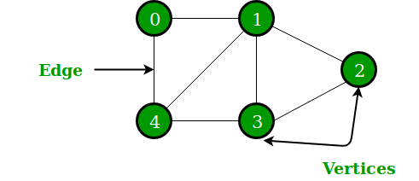
Introduction
A Graph is a non-linear data structure consisting of nodes and edges.
A Graph consists of a finite set of vertices(or nodes) and set of Edges which connect a pair of nodes.
In the above Graph, the set of vertices V = {0,1,2,3,4} and the set of edges E = {01, 12, 23, 34, 04, 14, 13}.

Slide 3
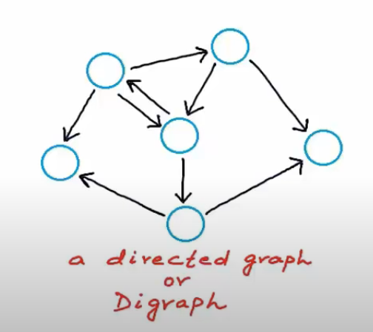
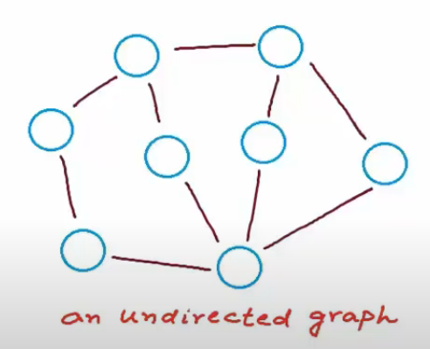
Introduction

Slide 4
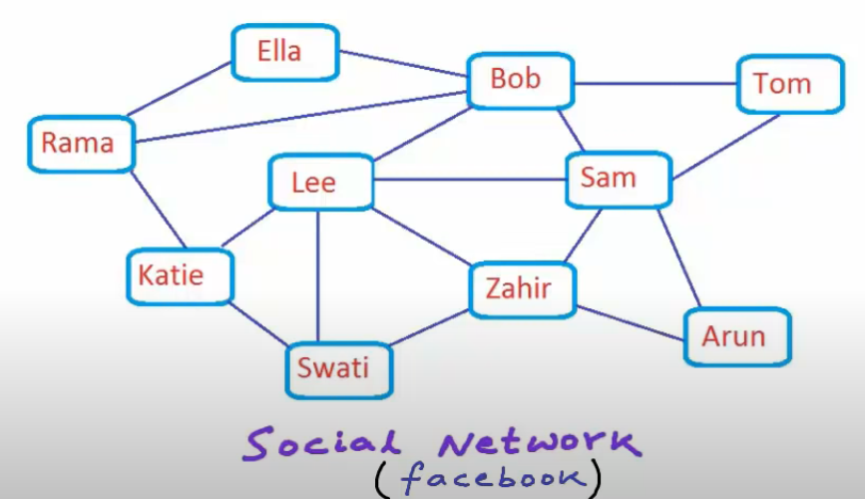
Introduction
Graphs are used to solve many real-life problems.
Graphs are used to represent networks.
The networks may include paths in a city or
telephone network or circuit network.
Graphs are also used in social networks like
linkedIn, Facebook.
For example, in Facebook, each person is
represented with a vertex(or node). Each
node is a structure and contains information
like person id, name, gender, locale etc.
Notes:
To recommend a friend the problem for the graph can be like find all the nodes that are having distance from a specific node less then 2.

Slide 5
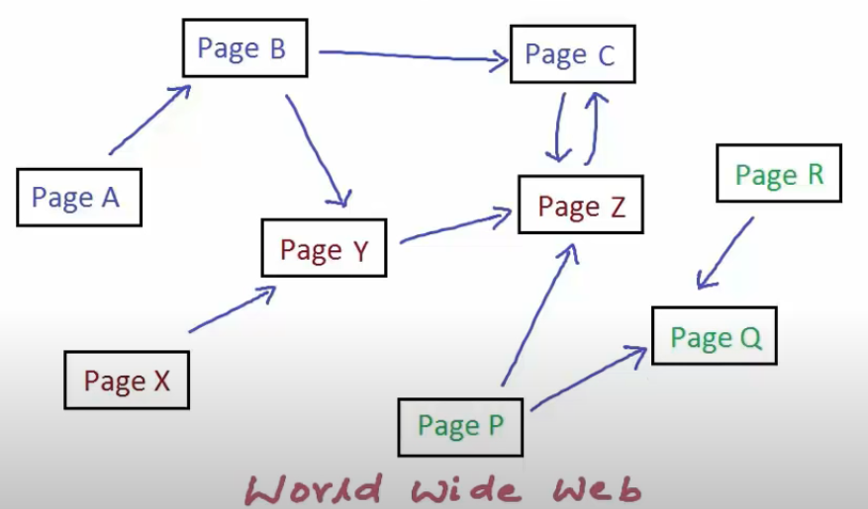
Introduction
World Wide Web can be represented as a directed graph.
A web page with unique address or url can be a node in this graph.
And a node can have a directed edge if that node or page has link to another page.
Notes:
web crawlers use this graph to traverse all nodes in the graph by visiting all the nodes connected with edge from the source node.

Slide 6
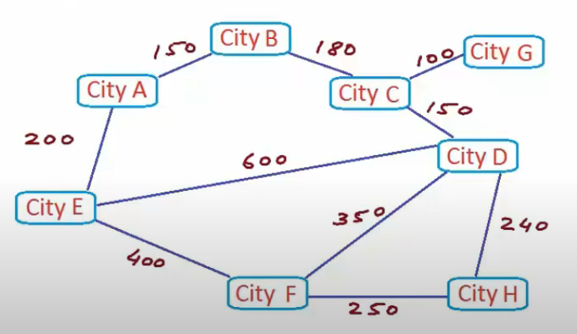
Introduction
Unweighted Graph
A weighted graph with all edges having weight = 1 unit.
Intercity Road Network

Slide 7
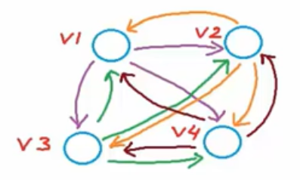
Properties
Number of edges:
if |v| = n
then,
0 <= |E| <= n(n-1), if directed
0 <= |E| <= (n(n-1))/2, if undirected
Dense → Too many edges (close to max no. of edges)
Sparse → Too few edges (close to no. of vertices)

Slide 8
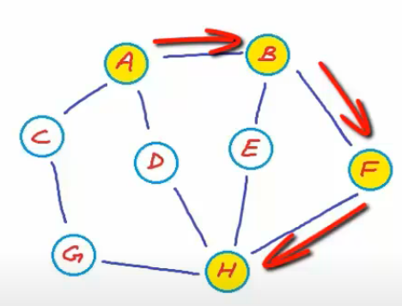
Properties
Walk:
A sequence of vertices where each adjacent pair is connected by an edge.
Path (Simple) :
A walk in which no vertices (and thus no edges) are repeated.
Trail:
A walk in which no edges are repeated.
Closed Walk:
starts and ends at same vertex.
Cycle:
no repetition other than start and end.
<A, B, F, H>
Notes:
<A, B, F, H> → simple path
<A, B, F, H, E, B, A, D> → walk
<A, B, E, H, D, A, C> → trail
<A, B, E, H, D, A> → closed walk

Slide 9
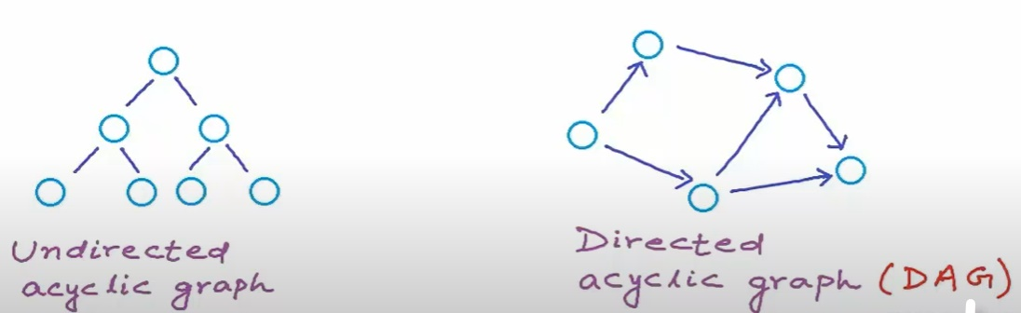
Properties
Acyclic Graph:
A graph with no cycle.
Notes:
A tree is undirected acyclic graph
There can be undirected acyclic graphs which are not trees and they are known as DAG.

Slide 10
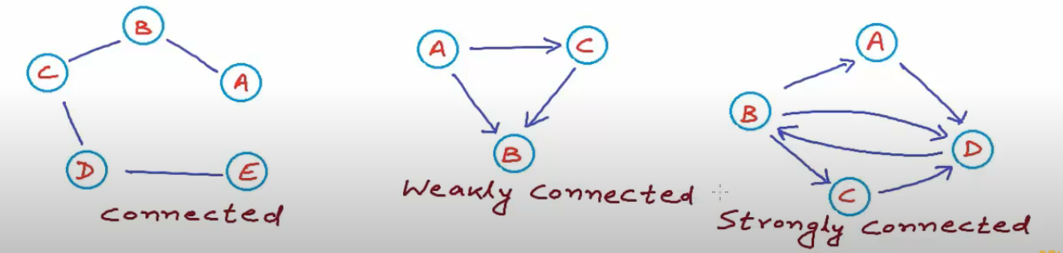
Properties
Strongly Connected Graphs:
if there is a path from any vertex to any other vertex.
Notes:
(i) if undirected graph, and there is path from any vertex to any other vertex, we simply call it connected.
(ii) if directed graph, and is not strongly connected but can be converted into connected graph by treating all edges as undirected then such graph is called weakly connected graph.
(iii) if directed graph, and there is path from any vertex to any other vertex, we call it strongly connected.

Slide 11
Representation
There are generally two ways to represent a graph data structure:
Adjacency Matrix
Adjacency List
There are other representations also like, Incidence Matrix and Incidence List.
The choice of the graph representation is situation specific.
It totally depends on the type of operations to be performed and ease of use.

Slide 12
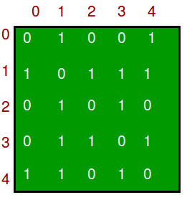
Adjacency Matrix
Adjacency Matrix is a 2D array of size V x V where V is the number of vertices in a graph.
Let the 2D array be adj[][], a slot adj[i][j] = 1 indicates that there is an edge from vertex i to vertex j. Adjacency matrix for undirected graph is always symmetric.
Adjacency Matrix is also used to represent weighted graphs.
If adj[i][j] = w, then there is an edge from vertex i to vertex j with weight w and all other values will be filled with some highest value or infinity.

Slide 13
Adjacency Matrix
Pros: Representation is easier to implement and follow. Removing an edge takes O(1) time. Queries like whether there is an edge from vertex ‘u’ to vertex ‘v’ are efficient and can be done O(1).
Cons: Consumes more space O(V^2). Even if the graph is sparse(contains less number of edges), it consumes the same space. Adding a vertex is O(V^2) time.

Slide 14
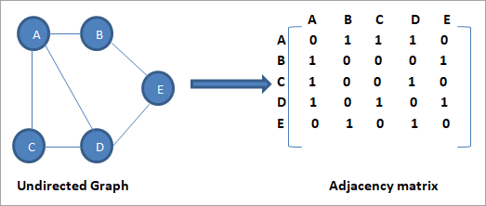
Adjacency Matrix

Slide 15
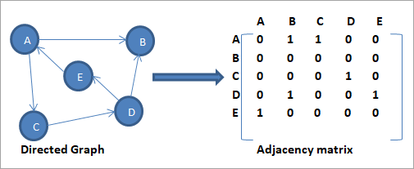
Adjacency Matrix

Slide 16
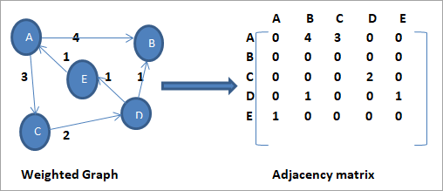
Adjacency Matrix

Slide 17
Adjacency Matrix - Representation
// undirected dense graph
int adj_matrix[N][N];
int main(){
int num_nodes, num_edges;
cin >> num_nodes >> num_edges;
for(int i = 0, u, v; i < num_edges; ++i){
// take nodes between which we have an edge
cin >> u >> v;
// undirected so we mark both (u, v) and (v, u) as 1
adj_matrix[u][v] = 1;
adj_matrix[v][u] = 1;
} // do something with the graph
}

Slide 18
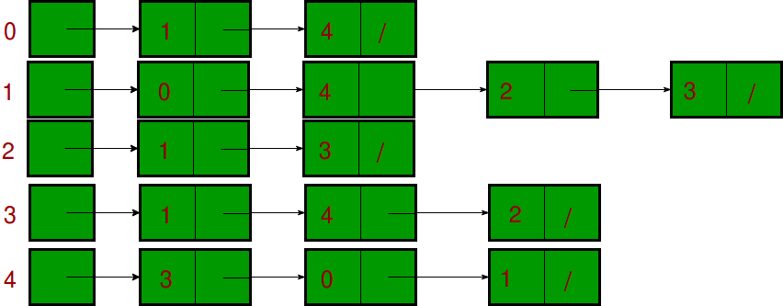
Adjacency List
An array of lists is used.
Size of the array is equal to the number of vertices.
Let the array be array[].
An entry array[i] represents the list of vertices adjacent to the ith vertex.
This representation can also be used to
represent a weighted graph.
The weights of edges can be represented as lists of pairs.

Slide 19
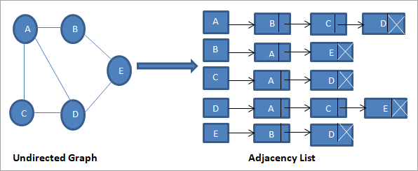
Adjacency List

Slide 20
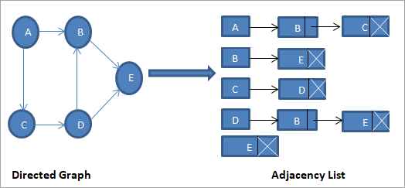
Adjacency List

Slide 21
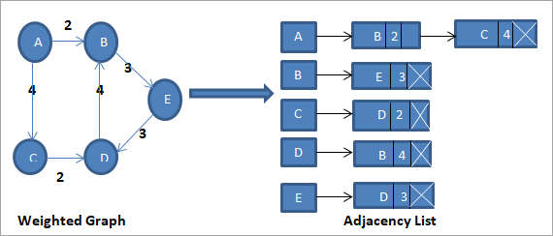
Adjacency List

Slide 22
Adjacency List - Representation
vector <vector <int> > adj_list;
int main(){
int num_nodes, num_edges;
cin >> num_nodes >> num_edges;
adj_list.resize(num_nodes+1);
for(int i = 0, u, v; i < num_edges; ++i){
// take nodes between which we have an edge
cin >> u >> v;
// undirected so we push v to list of u and vice versa
adj_list[u].push_back(v);
adj_list[v].push_back(u);
} // do something with the graph
}

Slide 23
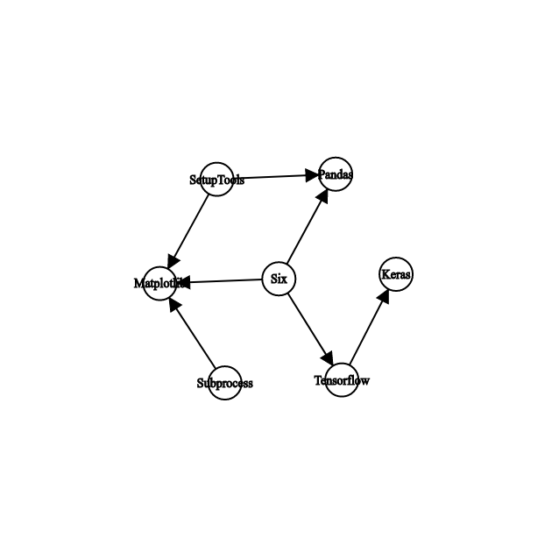
Application
The enthusiastic data scientist inside us wants to install some package to our system. But it depends on some other package which depends on some other and so on…. How many packages will you end up installing?
Often software dependencies are directed and can be modelled as a directed graph.
An edge from A to B denotes that B depends on A for its installation.

Slide 24
Application
How many packages are required to install Matplotlib? The answer is 3. How? We see the incoming edges to Matplotlib. :/
But is that it? Consider the case of Keras? What all is required for its installation? Clearly we need Tensorflow, which again requires Six to be available. So, here the answer is 2.
How to approach this problem?

Slide 25
Application
Let’s reverse the edges and see where we can reach from given package to be installed. Where-ever we reach is a dependency and needs to be installed before the package itself.

Slide 26
Traversal
There are two ways to do traverse a graph.
Let’s say you have a precious object which fell into a pool! Now you are searching for it in the pool. How will you do it?
Depth First Search: You start with some point on the pool’s surface, go as deep as you can (to the floor of the pool) and come back. If you don’t find your object, you take some neighbouring point on the surface and repeat the process.
Breadth First Search: You first search the entire surface of pool. Then go deep slighty and search entire area. Then a bit more deep and so on…

Slide 27
Depth First Traversal (DFS)
It is best option when trying to check if a graph is connected or not:
First it visits the starting node, which we call the root, and pushes it in a stack.
While the stack is not empty, the node at the top is examined and one of these two actions takes place:
If the node has unvisited neighbours, one of them is chosen, visited and pushed in the stack.
Otherwise, if all the node's neighbours had previously been visited the node presents no further interest and it is popped from the stack.
When the stack becomes empty it means that all the accessible nodes have been visited, so the algorithm ends.

Slide 28
Depth First Traversal (DFS)
int dfs(int node) {
int visCount = 1; //visited count
visited[node] = true;
for (int i=0; i<graph[node].size(); i++) {
if (!visited[graph[node][i]]) {
visCount += dfs(graph[node][i]);
}
}
return visCount;
}
Notes:
https://csacademy.com/lesson/depth_first_search/ ->video demo
https://www.techiedelight.com/depth-first-search/ -> iterative and recursive implementation

Slide 29
Breadth First Traversal (BFS)
It is one of the most common algorithms used to determine if a graph is connected or not. The steps of the BFS are the following:
Start by visiting one arbitrary vertex, which we call the root.
Visit all the root's neighbours and push them into a queue.
Pop the first node from the queue, visit all its neighbours and push into the queue those neighbours that have not been previously visited.
Repeat step 3 while the queue is not empty.
Finally, when the queue becomes empty it means all the reachable nodes have been visited, so the algorithm finishes.

Slide 30
Breadth First Traversal (BFS)
int bfs(int startNode) {
queue<int> bfsQueue;
vector<bool> visited(n);
int visCount = 0;
visited[startNode] = true;
bfsQueue.push(startNode);
while (!bfsQueue.empty()) {
int currentNode = bfsQueue.pop();
for (int i=0; i<graph[currentNode].size(); i++) {
if (!visited[graph[currentNode][i]]) {
visited[graph[currentNode][i]] = true;
bfsQueue.push(graph[currentNode][i]);
}
}
visCount += 1;
}
return visCount;
}
Notes:
https://csacademy.com/lesson/breadth_first_search/ -> video demo
https://www.techiedelight.com/breadth-first-search/ -> iterative and recursive implementation

Slide 31
What’s the time complexity ?
Given we have n nodes and m edges. We are going on each node once (thanks to visited array) and we also go on each of the edges once (consider the for loop in the function). So the complexity is O(n+m) for this implementation.

